Slide 1


Housing prices dataset
Alexander Zaitsev

Slide 2


Agenda
01
Overview of the dataset
Subject, source, variables
02
Data preparation
Encoding, missings, scaling
03
Prediction task
House price prediction
04
Classification task
House quality prediction

Slide 3
Agenda
01
Overview of the dataset
Subject, source, variables
02
Data preparation
Encoding, missings, scaling
03
Prediction task
House price prediction
04
Classification task
House quality prediction

Slide 4
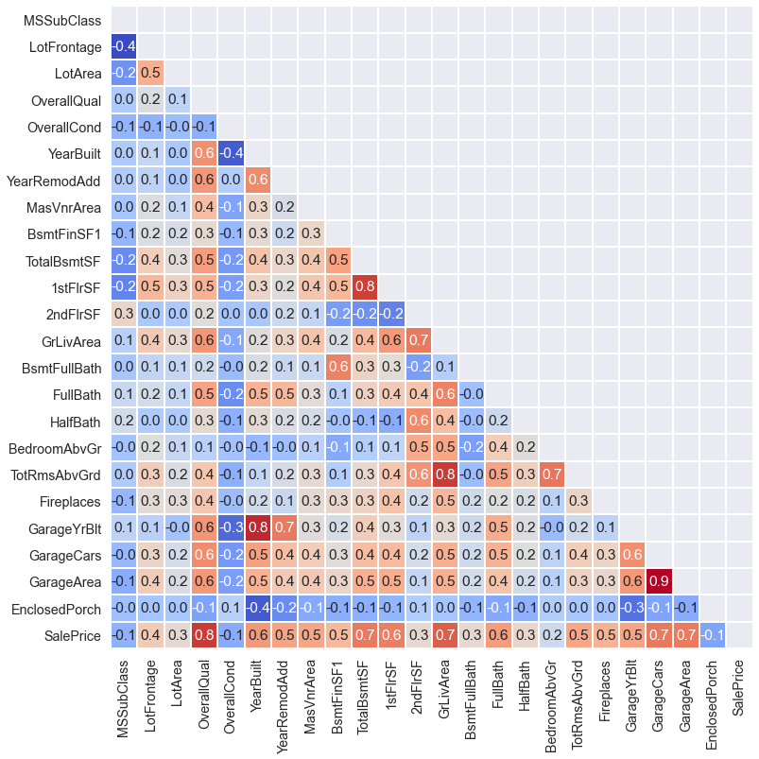
Dataset overview
Sale years:
Observations:
Variables:
12 floats,
25 integers,
43 objects
from 2006 to 2010
2919
80
Dataset contains:
Area
Surroundings
Materials
Quality
Floors
Conviniences
Variables with |corr|>=0.3

Slide 5
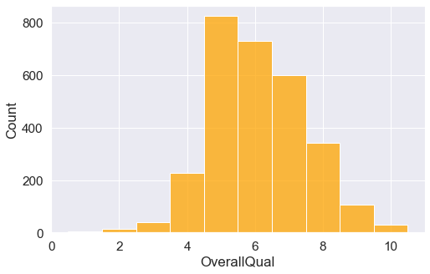
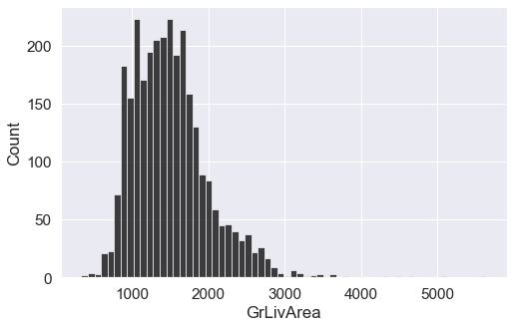
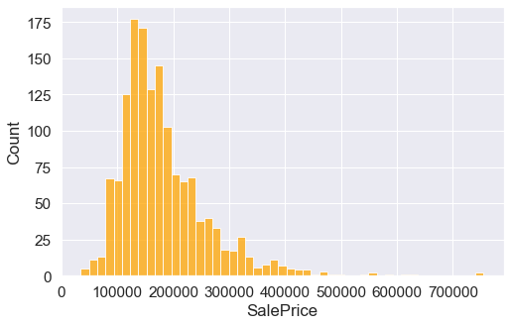
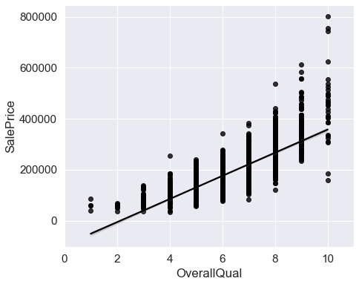
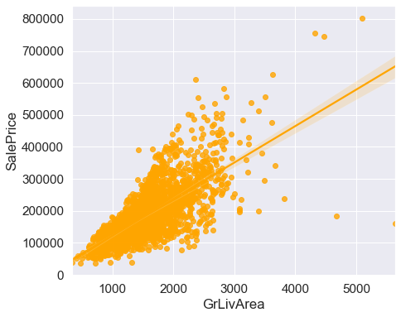
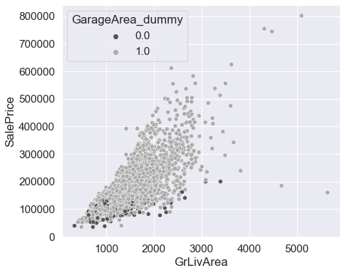
Graphical analysis
95% of houses are with garage

Slide 6
Agenda
01
Overview of the dataset
Subject, source, variables
02
Data preparation
Encoding, missings, scaling
03
Prediction task
House price prediction
04
Classification task
House quality prediction

Slide 7
Preparing data for analysis
Encoding
Adding new features
Splitting
Using one-hot-encoding
Into train and test samples, test size = 30%
If a feature has many zero values
1
3
5
2
4
Filling NaNs
Scaling
Using simple mean
To get a normal distribution for numeric features

Slide 8
Agenda
01
Overview of the dataset
Subject, source, variables
02
Data preparation
Encoding, missings, scaling
03
Prediction task
House price prediction
04
Classification task
House quality prediction

Slide 9

Price prediction task
01
Choosing best parameters
Using GridSearchCV we chose best regularization penalties
02
Choosing best model
Checking for overfitting
Calculating metrics on test sample
03
Economic overview
Looking for the most significant and insignificant features determining the price

Slide 10
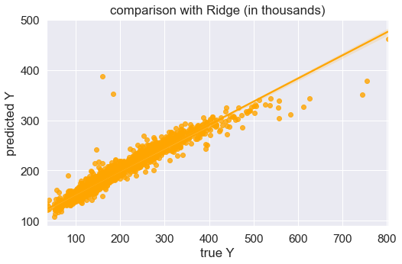
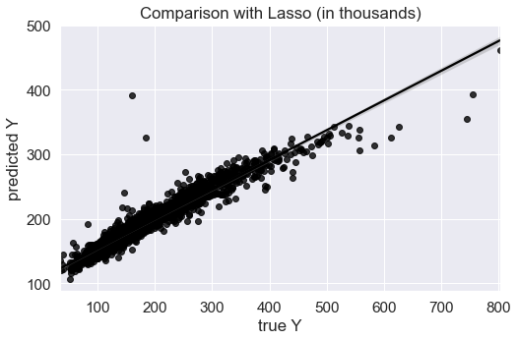
Price prediction task
Linear model
 | MSE | R_squared
Train | 302e+6 | 0.95
Test | 2.05e+24 | -356e+12
Overfitting problem!
Used regularization methods
Lasso best alpha = 75.4312
Ridge best alpha = 14.5635
Elastic Net best alpha = 0.005, best l1_ratio = 0.005
Metrics |  | Lasso | Ridge | Elastic net
R^2 | train | 0.9264 | 0.9243 | 0.9262
 | test | 0.9330 | 0.9354 | 0.9346
MSE | train | 476e+6 | 490e+6 | 478e+6
 | test | 386e+6 | 372e+6 | 377e+6

Slide 11
Key findings
Overfitting problems
The most significant features
Simple LR faced overfitting problems
Implementing regularization significantly improved LR model’s quality
Proximity to second main road or railroad
Some roof materials (кровля)
Physical locations within Ames city limits
Kitchen quality
Above grade (ground) living area square feet
General shape of property
Prediction
The most insignificant features
Both Lasso and Ridge showed good prediction results
(In test the Ridge wins, In train Lasso wins)
Elastic Net showed slightly lower quality
Exterior
Foundation (фундамент)
House and roof style
Type of sale
Paved driveway
Type of heating
Electrical system

Slide 12
Agenda
01
Overview of the dataset
Subject, source, variables
02
Data preparation
Encoding, missings, scaling
03
Prediction task
House price prediction
04
Classification task
House quality prediction

Slide 13
Classification task
01
Creating new feature
If OverallQual >= 7: the house has high quality
Else: The house has low quality
37% of observations are positive
02
Choosing best parameters
Using GridSearchCV we chose:
best regularization penalties,
best window size for SVM
03
Choosing best model
Checking for overfitting
Calculating metrics on test sample

Slide 14
Classification scores on test sample
Models | Logit | Logit+l1 C=0.62 | Logit+l2 C=0.04 | SVM С=123
Accuracy | 0.89 | 0.88 | 0.89 | 0.88
Precision | 0.91 | 0.87 | 0.91 | 0.89
Recall | 0.81 | 0.82 | 0.81 | 0.79
F1 | 0.86 | 0.84 | 0.85 | 0.84
ROC-AUC | 0.953 | 0.946 | 0.952 | -

Slide 15

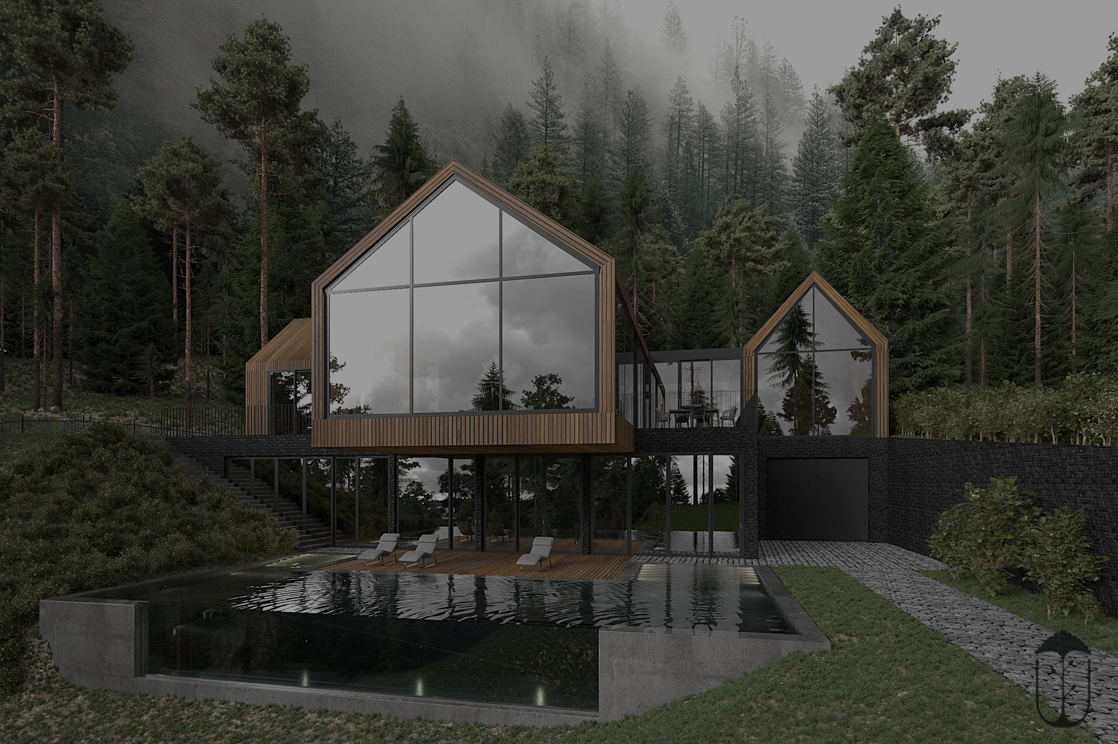
Forest
“Но правильный подход это, конечно же, выбирать тюнинг параметр, глубину дерева или количество соседей через кроссвалидацию… или брать подмножество данных, или как то ещё. Соответственно, надо построить много деревьев и сравнивать их перформанс на разных сэмплах, это и называется ЛЕС.”
(c) Павел Павлович Андреянов

Slide 16
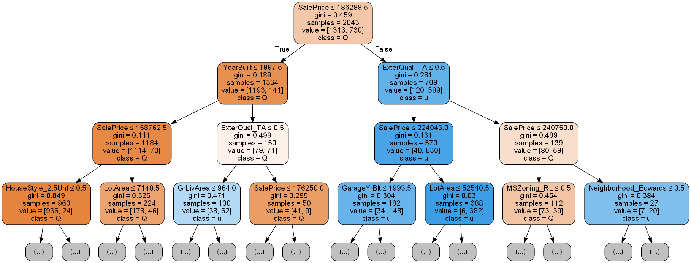
Forest of single trees
Trees with K-fold Cross-Validation: depth as hyperparameter
Why do we need CV in trees?
General characteristics
By using cross validation, we can prevent overfitting and capture nonlinear boundary separating the classes
Forest was trained on f1, guarantee maximum accuracy on depth of 7
Almost 84.5% of variables are insignificant
Sale prices plays more than 64% role, and exterior material quality 9%.
Std is low

Slide 17
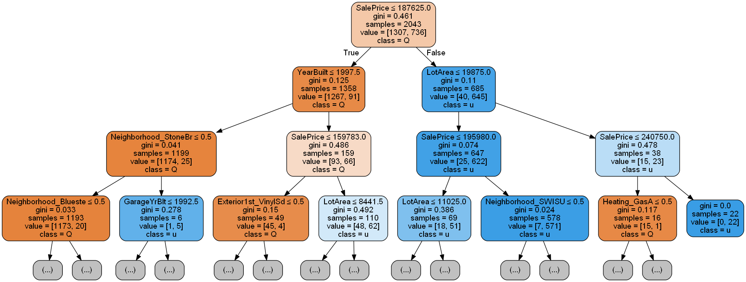
Forest of single trees
Trees with K-fold Cross-Validation: depth and KNN as hyperparameters
Why do we need CV in trees?
General characteristics
By using cross validation, we can prevent overfitting and capture nonlinear boundary separating the classes
Forest was trained on f1, guarantee maximum accuracy on depth of 9 and neighbors of 9
Almost 88% of variables are insignificant
Sale prices plays more than 81% role lot size in a square feet 7%
Std is low

Slide 18
Classification scores on test sample
The usual logistic regression shows the best results for all quality metrics
Models | Logit | Tree depth and neighbours | Tree depth
Accuracy | 0.89 | 0.87 | 0.87
Precision | 0.91 | 0.86 | 0.9
Recall | 0.81 | 0.8 | 0.77
F1 | 0.86 | 0.83 | 0.83
ROC-AUC | 0.953 | 0.86 | 0.89

Slide 19
Overall Summary
Linear regression with L2 regularization shows best results
House loсation, roof material, kitchen and shape pf property are the most significant
Interesting, that foundation and exterior are not significant
The usual logistic regression slightly outperforms over models
All models show good results

Slide 20

THANK YOU
Thank you for your attention

